Slide 1
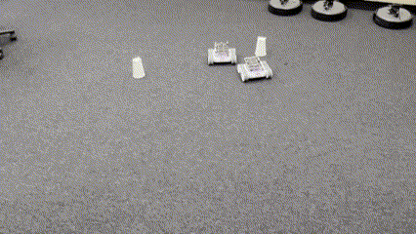
Emergent Behaviours in Heterogeneous Boid Swarms of RVR and BOLT Robots
Nicholas Liu
z5364371

Slide 2
Introduction
Aim:
  To create emergent behaviours within heterogeneous swarms of RVR and BOLT robots
Significance:
  Limited implementation of heterogeneous swarms using low cost commercially available robots
  Formations in heterogeneous swarms are created using a top – down ‘control’ strategy vs. emergent collective behaviour
  Emergent behaviours shows promise in increased robustness and decreased complexity over traditional formation control techniques
Notes:
There is currently no work implementing boid swarms on heterogeneous swarms of low cost commercially available robots, with emergent behaviours offering similar outcomes to other formation control methods however having significantly higher computational efficiency they are very useful for optimising robotic swarms.
Hence to address the gap in knowledge, the aim of this project is to create a heterogeneous swarm of RVR and BOLT robots and to generate and observe emergent swarming behaviours within this swarm.

Slide 3
Related Work
Boid Swarming
  Flocks, herds and schools: A distributed behavioral model – Reynolds, 1986
Emergent Behaviour
  Autonomous detection of collective behaviours in swarms – Khan et al, 2020
Behavioral Metrics
  Automatic Recognition of Collective Emergent Behaviors Using Behavioral Metric – Yang et al, 2023
Notes:
Boids model is the foundation of this work, this project uses this model
Emergent behaviours used within the report are generated from the papers by Khan and Yang

Slide 4
Heterogeneous Swarm Design Methodology
Boid swarm, agents interact locally through separation, cohesion and alignment
Centralised control framework
Notes:
The heterogeneous swarm is a boid swarm by nature, utilising each of the boid rules of separation cohesion and alignment
This is utilised within this project to create emergent behaviour as boid swarms are most accepting of emergent behaviour due to them having no requirement for a goal
Initially a decentralised control framework was attempted, this ended up being unsuccessful for multiple reasons:
Communications links were not robust and stable enough
Caused too much data and calculations to occur on RVR resulting in delays

Slide 5
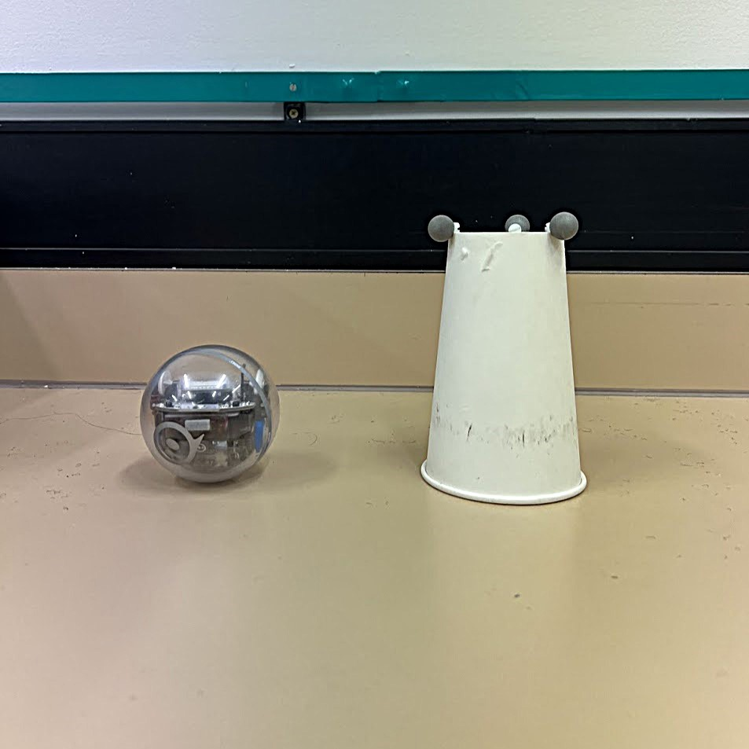
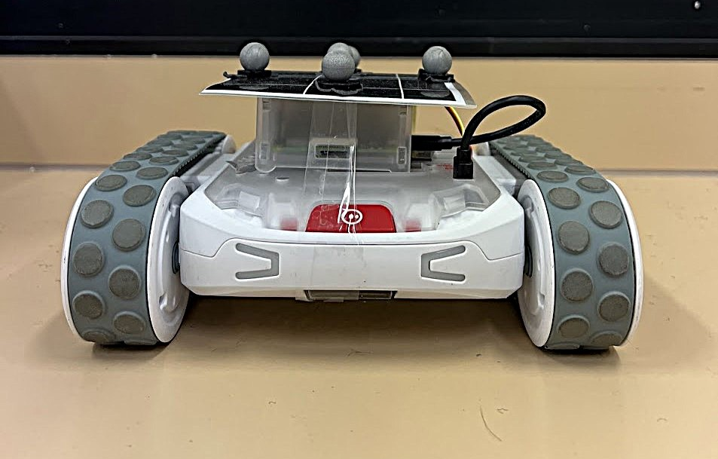

Materials
RVR robot
  Communicates with swarm controller through TCP sockets
BOLT robot
  Communicates with swarm controller through Bluetooth
VICON motion capture cameras
  Identifies robot locations and communicates them; acts as a local positioning system
Notes:
RVR has a raspberry pi, which communicates with the RVR through UART through wired connection while it communicates with the swarm controller over TCP socket
BOLT robot communicates through python bleak Bluetooth low energy library
While both have IR capability this was found to be too locked down to use, and while RVR had Bluetooth, experimentally it was found to be very susceptible to noise and became extremely difficult to connect to the Bluetooth and would frequently disconnect during testing

Slide 6
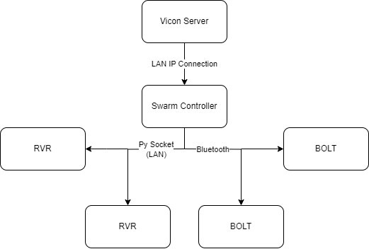
Heterogeneous Swarming Framework
Central swarm controller calculates and updates each agent with new velocities
Agents are individually passed class specific instructions by swarm controller
RVR uses RVR Script.py to listen for TCP socket commands
BOLT uses bleak library to directly interface with the
Notes:
Communications within robotic swarms is commonly a difficult problem, this is especially difficult within heterogeneous robots
Even though RVR and BOLT are of the same manufacturer they still use significantly different communications and control schemes, as RVR uses a Raspberry Pi that can connect over LAN while BOLT is only Bluetooth enabled.
The system functions by each agent initialising with set parameters, each agent operates as its own object, to update the agent’s velocity it passes its parameters to the central swarm controller which stores locations of all agents through VICON, this is then used to calculate the boid forces and update each agent’s velocity.
Following this each agent utilises its class specific methods to pass the updated velocity on to the robot, RVR through the use of TCP socket and BOLT through use of bleak library.

Slide 7
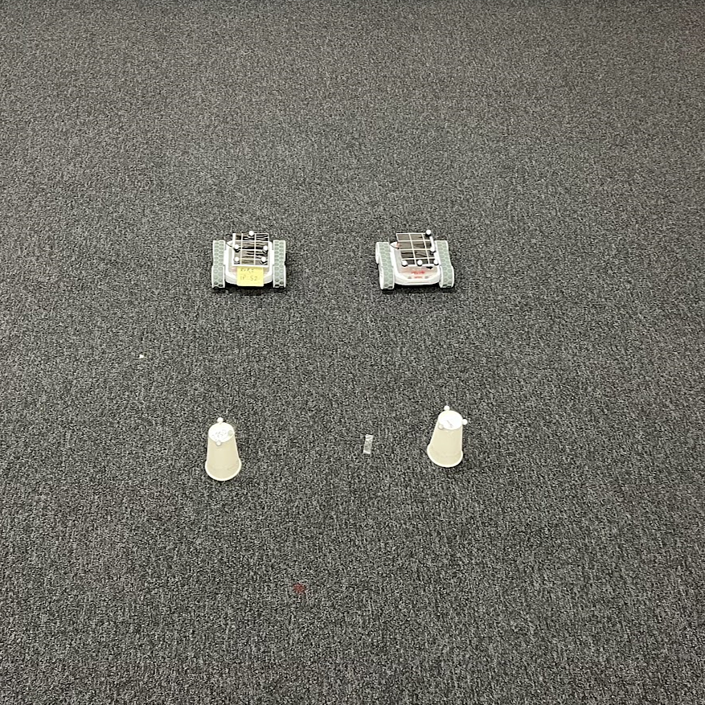
Experimental Methodology
Environmental setup is shown in the figure (right)
Validation tests conducted
  BOLT swarm
  RVR swarm
  Heterogeneous test swarm
Four unique behaviours studied
  Flocking
  Lines
  Gravity
  Random (control)
Notes:
The environment was a 2 x 2 m virtual square in which robots would bounce off this boundary, robots were set with the layout shown
The first studies conducted were those to validate that the system functioned as intended, this included a test of 3 BOLTs, 3 RVRs and 2 BOLTs and 1 RVR to show that each set would swarm
Following this four unique behaviours were studied:
Flocking
Lines
Gravity
Random (control)
These behaviours were based on existing literature (there aren’t clear definitions they just resemble things)

Slide 8
Parameter Tuning
Initial parameters are generated based on existing literature
Parameters on both BOLT and RVR are adjusted simultaneously and independently
Emergent behaviour is produced and data is collected through VICON
Notes:
Parameter tuning took place by first reviewing literature on homogeneous emergent behaviours, then using these performing multiple experiments to study and understand the effects of each parameter within the behaviour.
If RVR and BOLT began forming individual swarms the parameters would be typically adjusted independently in order to bring them back together – this is an example of intuitively tuning
Once the desired behaviour emerged four trials of each behaviour were run and the data produced was collected through VICON and analysed using pyplot

Slide 9
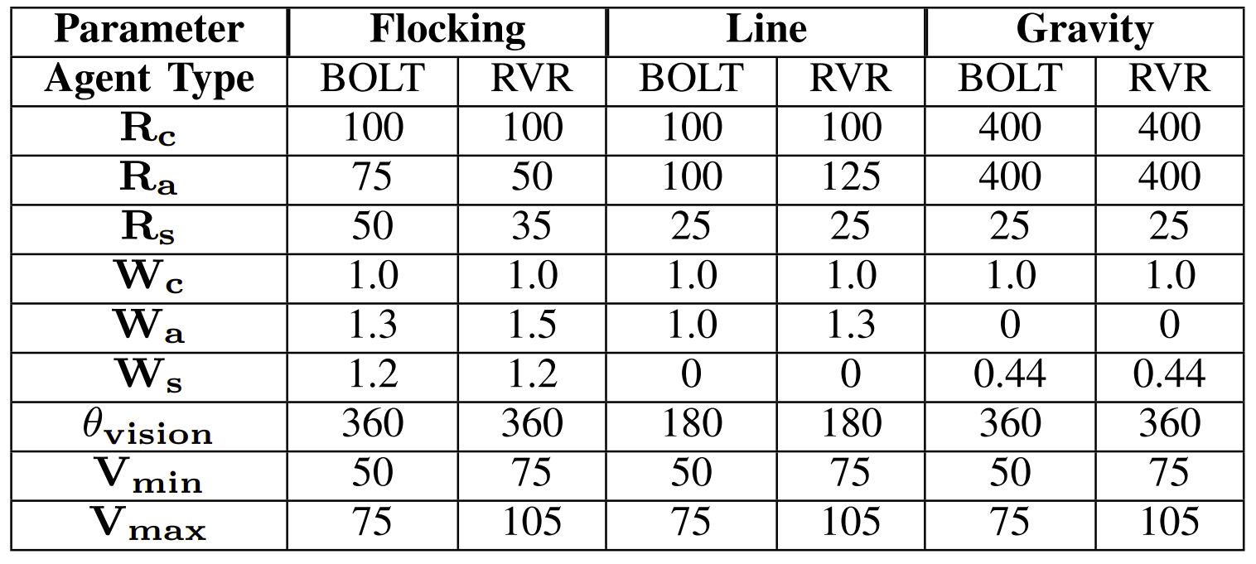
Parameter Setup
Notes:
These were the final parameters used within each studied behaviour, noting that random is not included as everything was 0,

Slide 10

Results Analysis
Swarms location data collected via VICON and analysed through metrics
Metrics used:
  Grouping – measure of average separation between swarm member
  $$s_{i}=\frac{1}{n−1}\sum_{j=1}^{n}{\left|b_{i}, b_{j}\right|}$$
  Order – measure of average alignment between swarm members
  $$Order =\frac{1}{n}\left|\sum_{i=1}^{n}{v_{i}}\right|$$
  Subgroup Count – measure of clusters of swarm members
Notes:
Higher grouping is further apart, lower grouping is closer together
Higher order is higher alignment between robot headings, lower order means more dispersion
Subgroup count – number of clusters of swarm members anything above 1 indicates that something is happening

Slide 11
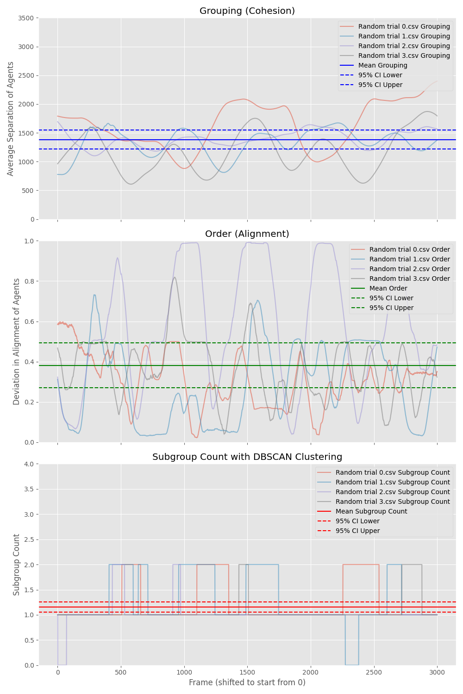
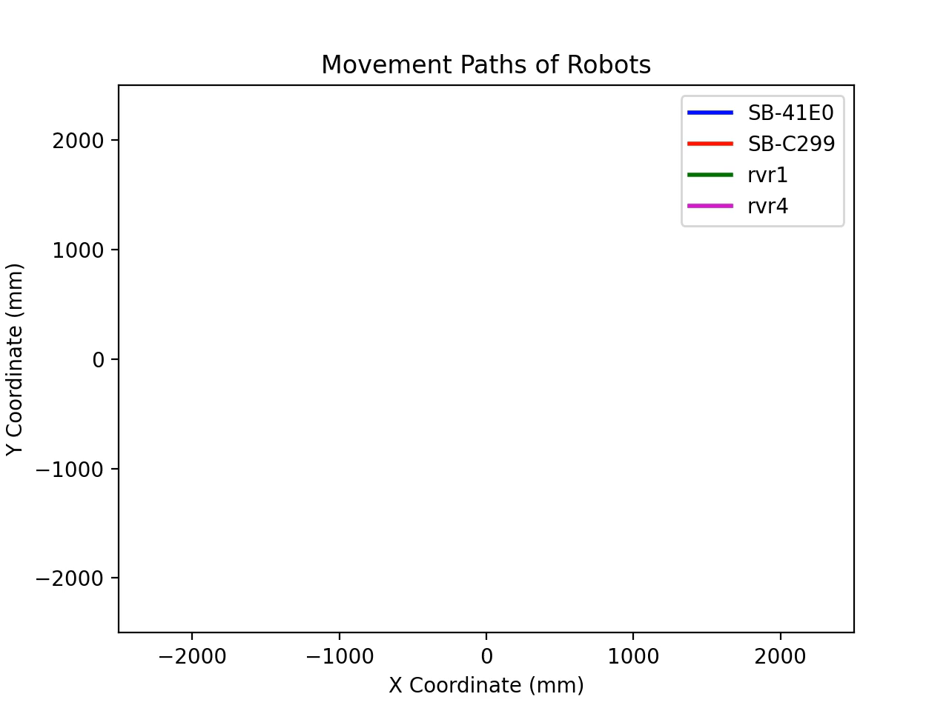
Random Study (control)
Is used as a control as this swarm has no weights and no radii, resulting in purely just wall bouncing behaviour (no swarming)
Notes:
This study acted as the control to analyse the other studies, the up and down motion is due to the wall rebound rule and no intentional stochastic movement introduced into the swarm

Slide 12
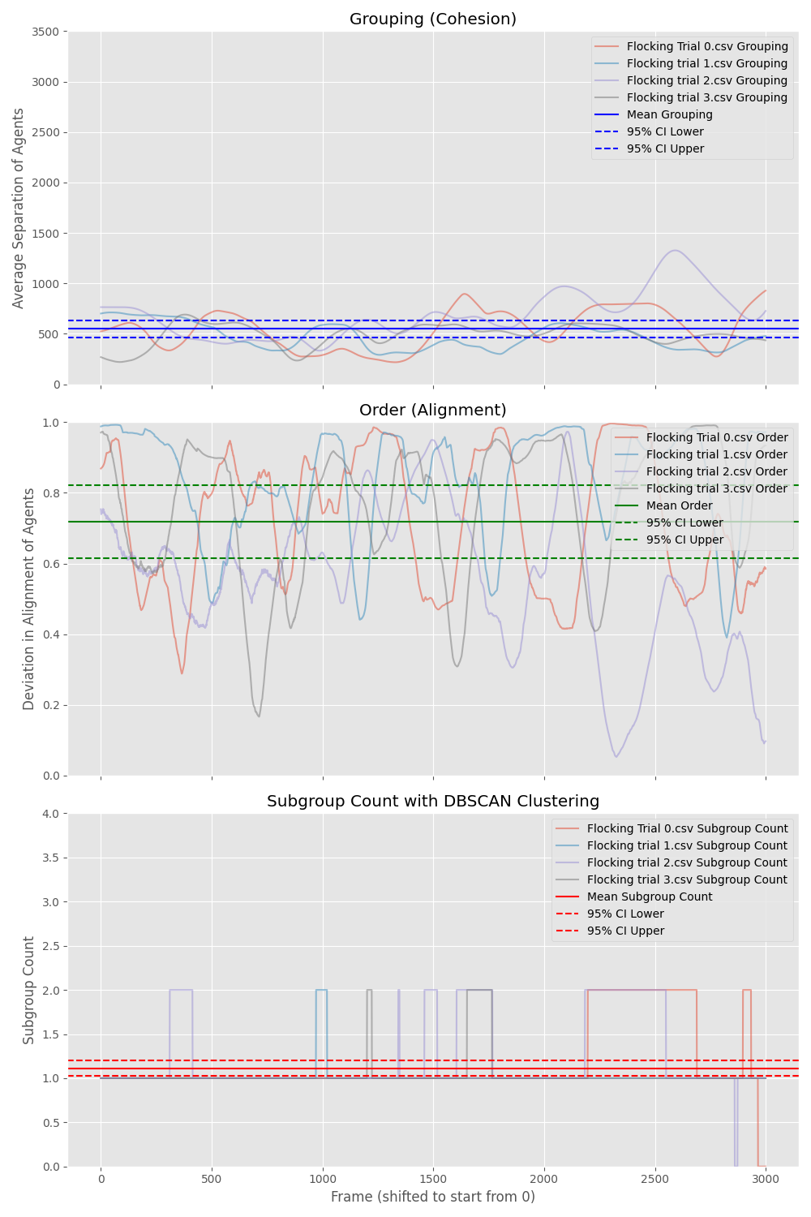

Flocking Study
Created through high cohesion and alignment radii and weight with 360 degree field of view
Inspired by birds flocking in a swarm
Notes:
This behaviour reflects the movement of a flock of birds, school of fish, insects etc. They move in a group in the same direction as their neighbours while avoiding collisions.
This could prove practical as the flocking behaviour allows the swarm of robots to quickly move across an area while also achieving a large scale of coverage, furthermore this behaviour increases robustness of the swarm in information and access denied scenarios.

Slide 13
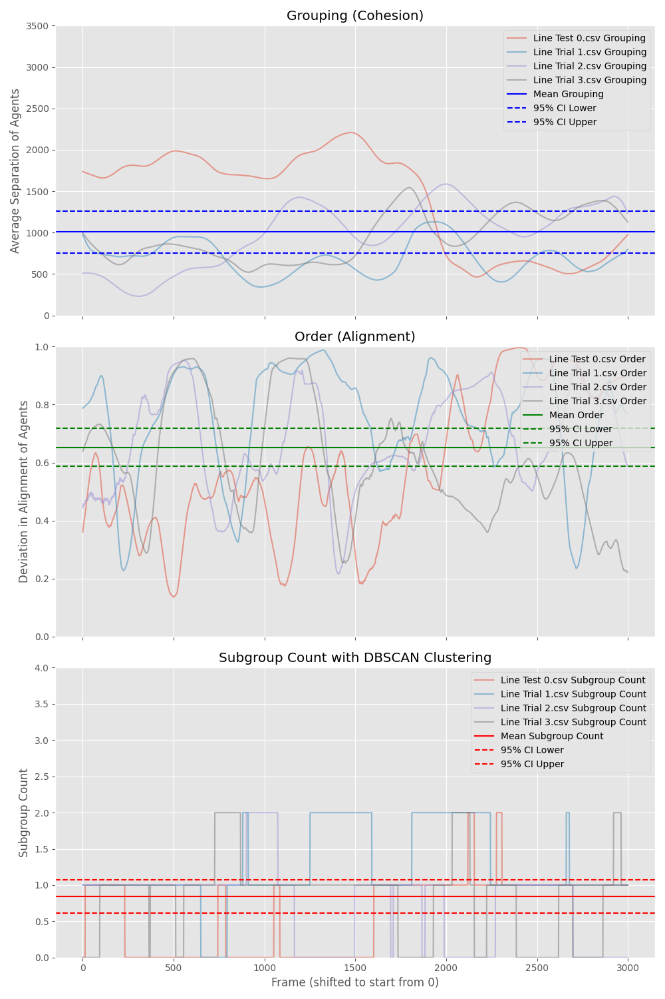

Line Study
Created through high cohesion and alignment radii and weight with 180 degree field of view
Inspired by ants moving in a line
Notes:
In this behaviour we can observe boids queuing one after the other and forming a line. They may split into several lines or multiple lines could merge together over time.
In the real world line following swarms are incredibly useful for large scale robust logistical transport which would increase their performance with the additional scalability and stability generated through an emergent behaviour.

Slide 14
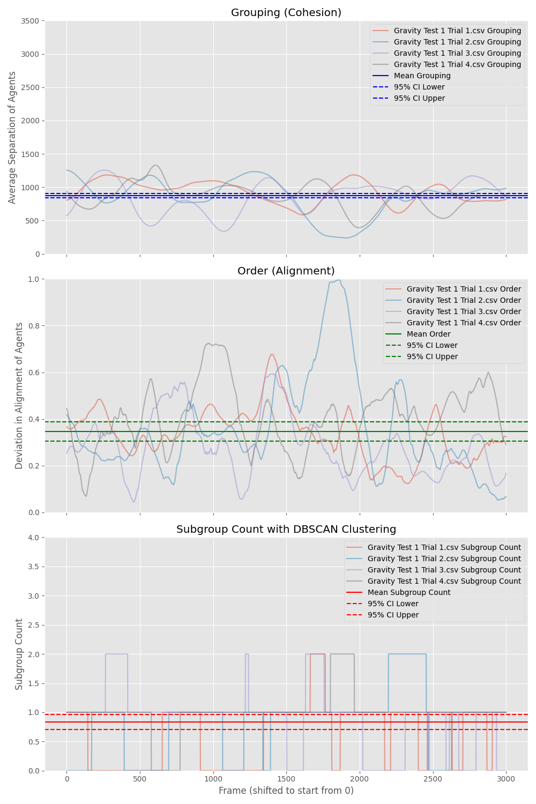

Gravity Study
Created through high cohesion and no alignment
Creates an orbiting pattern around a central point
Notes:
In this behaviour we can observe that with time, boids get attracted to other boids in the vicinity, forming tightly grouped clusters of boids due to high cohesion.
This could be utilised in a real world application for surveillance or long term monitoring, this would be especially useful for airborne swarms that are more energy efficient in orbiting patterns.

Slide 15
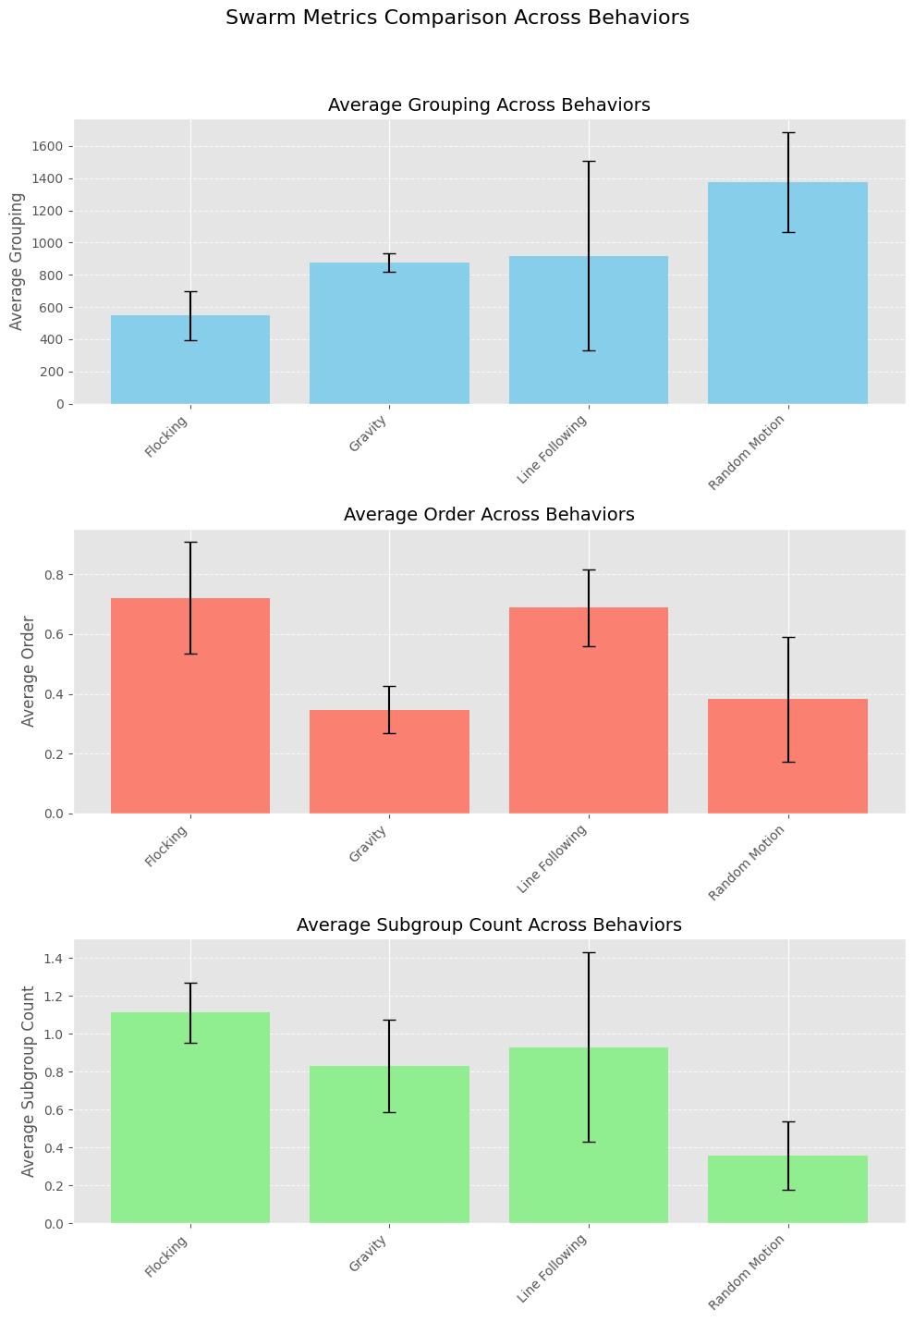
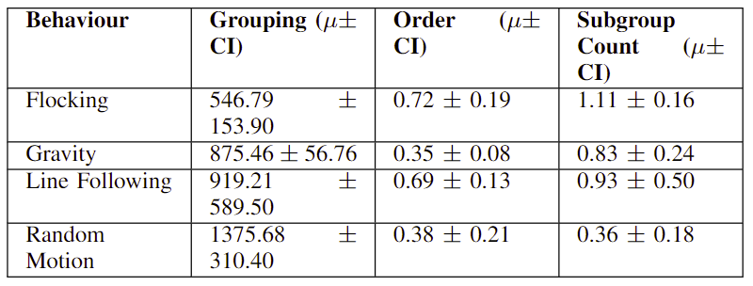
Results Summary
Metrics of the studied behaviours showed significant statistical difference between emergent behaviour and random motion
Notes:
Final Remarks:
The study confirms that different swarming behaviors can be quantitatively distinguished using specific metrics.
Understanding these behaviors allows for the development of more efficient and effective robotic swarms.
This research has implications for fields like search and rescue, environmental monitoring, and autonomous exploration.
Grouping
Definition: Measures the average separation between agents
Findings:
All behaviors have lower grouping values than random motion
Indicates successful convergence of agents
Line following shows larger variance
Due to decreased vision angle causing agents to occasionally lose the swarm
Order
Definition: Assesses the alignment of agents' movements
Findings:
Flocking and line following have significantly higher order values
Indicates better alignment among robots
Gravity behavior has lower order
Circular motion results in no consistent alignment
Subgroup Count
Definition: Number of separate groups within the swarm
Findings:
Swarming behaviors have higher subgroup counts than random motion
Suggests some splintering in swarming behaviors
Small differences are expected due to experimental constraints

Slide 16
Conclusion and Recommendations
Heterogeneous swarming with BOLT and RVR was achieved with three emergent behaviours produced:
  Flocking
  Lines
  Gravity
Future research could be:
  To experiment with asymmetric emergent behaviour
  To implement heterogeneous swarm in practical scenario
Notes:
This project showed that it was possible to use low cost BOLT and RVR robots to create a heterogeneous boid swarm and that it was possible for this to produce emergent behaviours
Future research could focus on experimenting with asymmetric heterogeneous emergent behaviour, implementing the heterogeneous swarm designed into a practical real world scenario, such as coverage or source localisation

Slide 17
Questions

